Slide 1
Introduction To C++
C++ is one of the most flexible and efficient general-purpose programming languages, which is a superset of C programming language where most tools and libraries supported in C could be used in C++ as well.
This introduction to the c++ article is divided into several sections starting from a general overview of the language to its advantages and disadvantages.

Slide 2
Overview of C++/OOPs
The advent of C++ happened in 1983 when Bjarne Stroustrup started working with ‘C with classes, which later got renamed to C++ that had few additional features like operator overloading, BCPL (Basic Combined Programming Language) style comments.
The idea behind C++ is that it is a compiled language which means the source program is compiled to produce object files that yield an executable program after getting combined by a linker.
The image below gives an idea of a program compilation in C++.

Slide 3
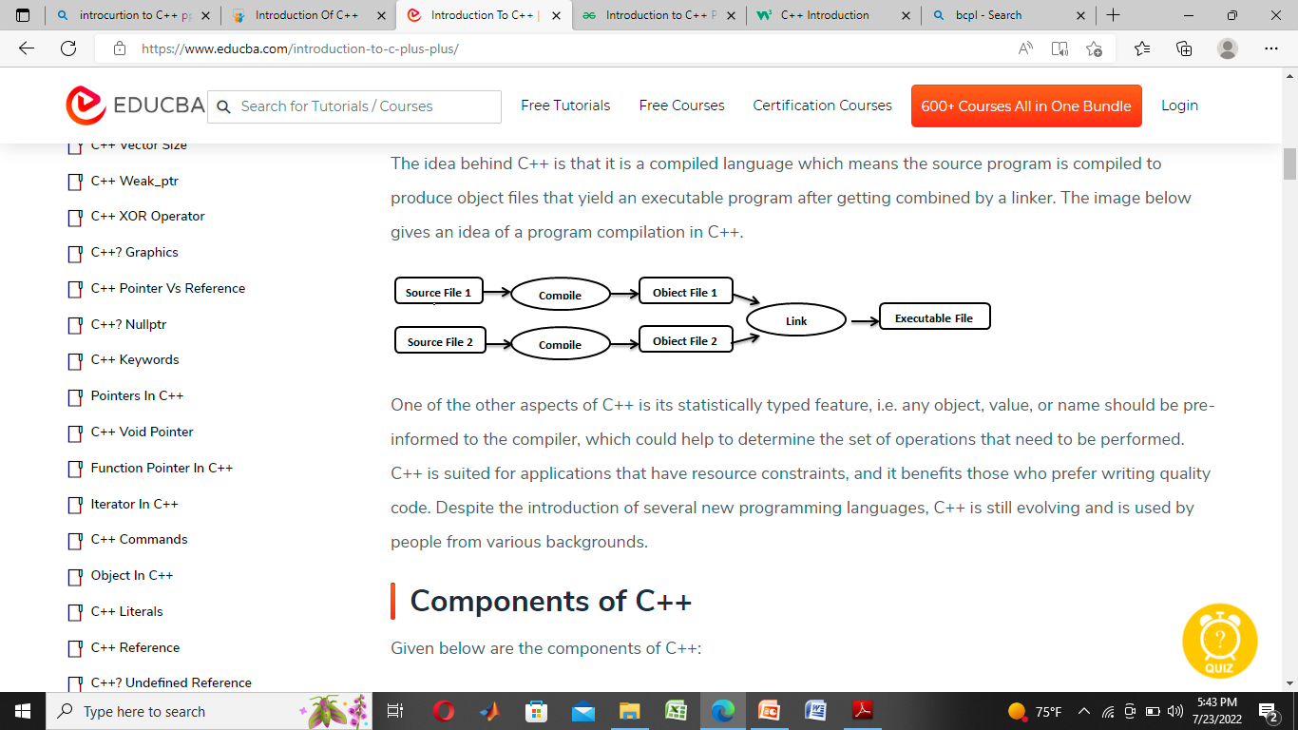
Overview of C++

Slide 4
Sample C++ Program
#include"iostream"
#include<string>
using namespace std;
int main()
{
string name;
cout <<"Please enter your name : ";
getline(cin,name);
cout<<"Your name is = "<<name;
return 0;
}

Slide 5
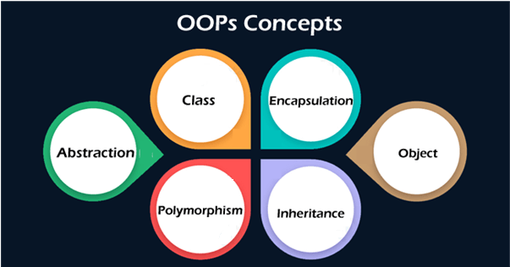
OOPs Concepts
The major concepts that we have discussed above are known as pillars of OOPs.

Slide 6
Object
An object is a real-world entity that has attributes, behavior, and properties. It is referred to as an instance of the class.
It contains member functions, variables that we have defined in the class. It occupies space in the memory. Different objects have different states or attributes, and behaviors.

Slide 7
Class
A class is a blueprint or template of an object. It is a user-defined data type. Inside a class, we define variables, constants, member functions, and other functionality.
it binds data and functions together in a single unit. It does not consume memory at run time.
Note that classes are not considered as a data structure.
It is a logical entity. It is the best example of data binding. Note that a class can exist without an object but vice-versa is not possible.
The following figure best illustrates the class and object in OOP.

Slide 8
Class: Human being. Object: Man.
Class: Color. Object: Red.
Class: Pets. Object: Dog.
Class: Wild animals. Object: Tiger.
Class: Drinks.

Slide 9
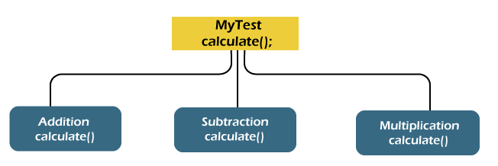
Abstraction
The concept allows us to hide the implementation from the user but shows only essential information to the user. Using the concept developer can easily make changes and added over time.

Slide 10
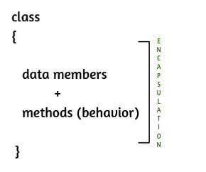
Encapsulation
Encapsulation is a mechanism that allows us to bind data and functions of a class into an entity. It protects data and functions from outside interference and misuse. Therefore, it also provides security. A class is the best example of encapsulation.

Slide 11
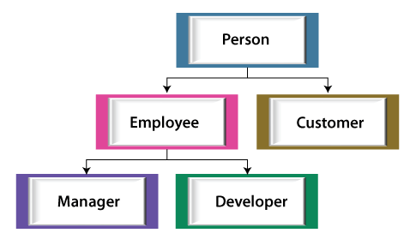
Inheritance
The concept allows us to inherit or acquire the properties of an existing class (parent class) into a newly created class (child class). It is known as inheritance. It provides code reusability.

Slide 12
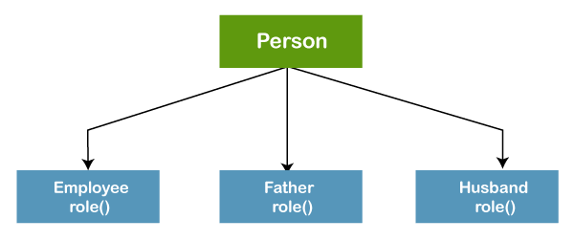
Polymorphism
The word polymorphism is derived from the two words i.e. ploy and morphs. Poly means many and morphs means forms. It allows us to create methods with the same name but different method signatures. It allows the developer to create clean, sensible, readable, and resilient code.

Slide 13
Data types
Data types in any of the language mean that what are the various type of data the variables can have in that particular language.
Information is stored in computer memory with different data types.
Whenever a variable is declared it becomes necessary to define a data type that what will be the type of data that variable can hold.

Slide 14
Primary(Built-in) Data Types
character
integer
floating point
boolean
double floating point
void
wide character

Slide 15
User Defined Data Types:
  Structure
  Union
  Class
  Enumeration
Derived Data Types:
  Array
  Function
  Pointer
  Reference

Slide 16
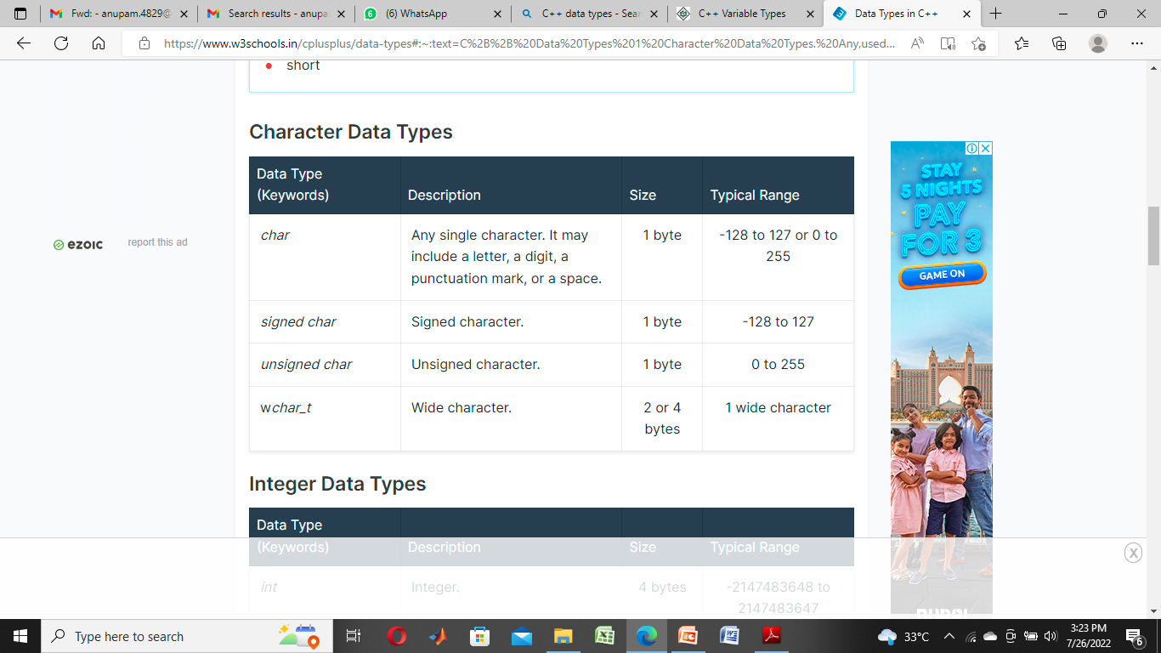

Slide 17
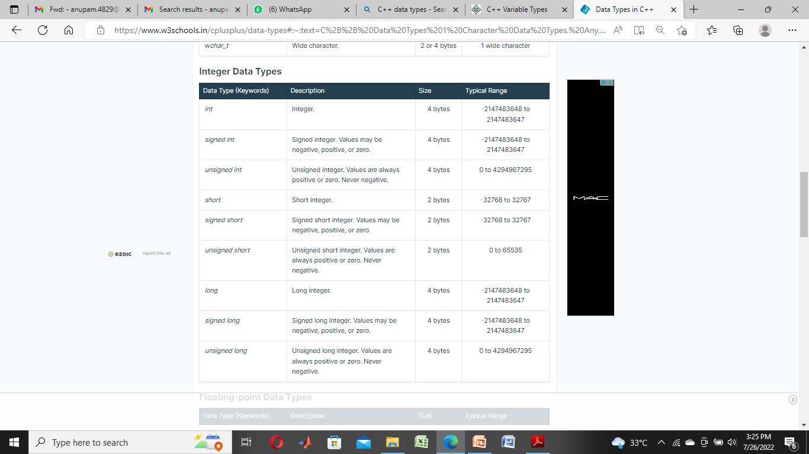

Slide 18
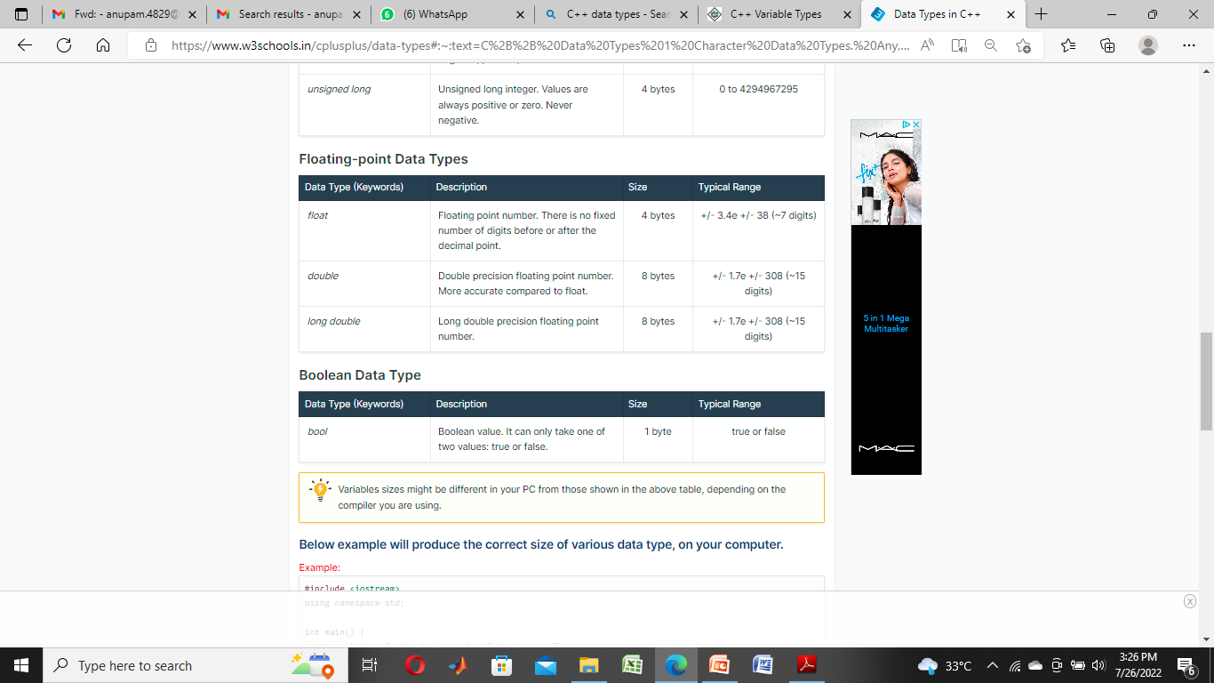

Slide 19
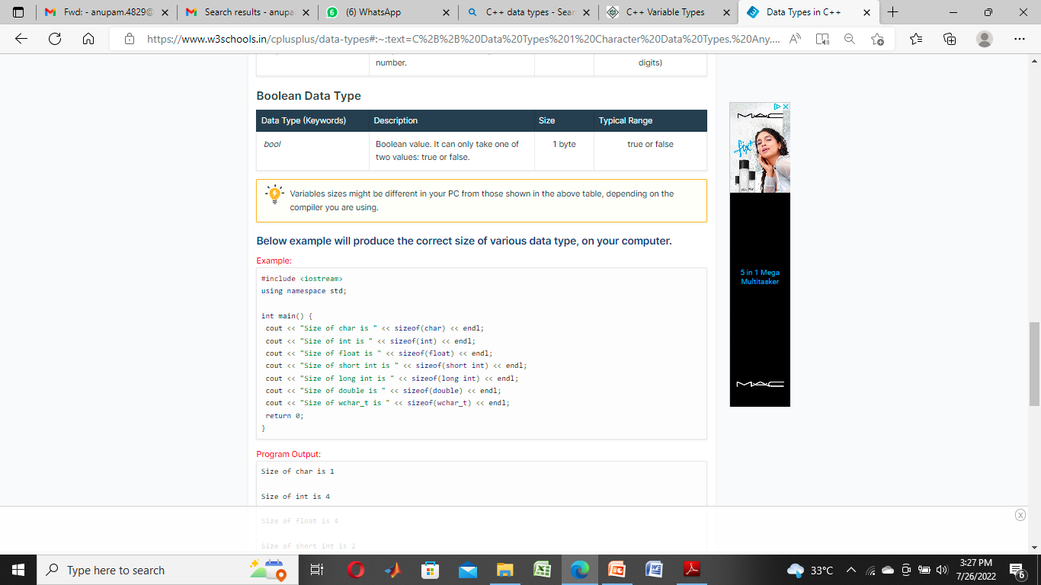

Slide 20
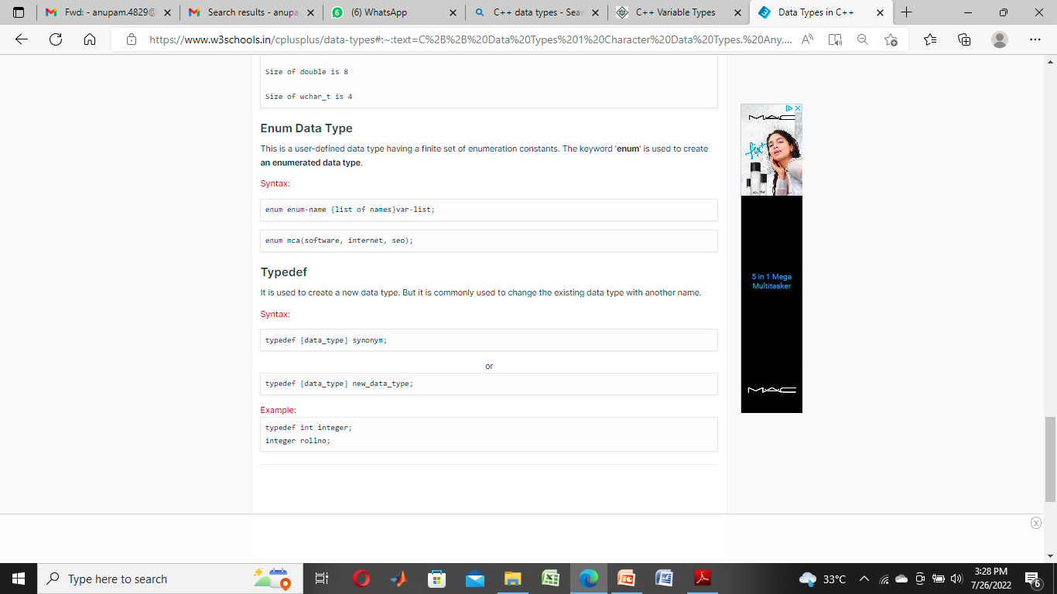
In this example, the name of the enumeration is season. The values spring, summer, autumn, and winter are values of type season. By default, spring is 0, summer is 1 and so on¹²³

Slide 21
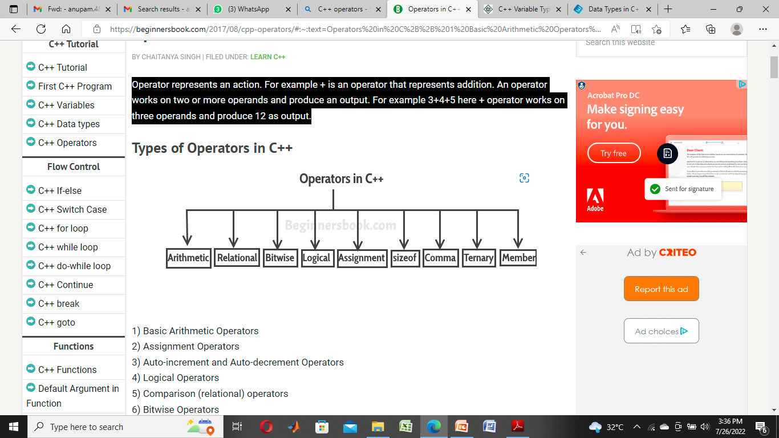
Operators in C++
Operator represents an action. For example + is an operator that represents addition.
An operator works on two or more operands and produce an output.
For example 3+4+5 here + operator works on three operands and produce 12 as output.

Slide 22
Basic Arithmetic Operators
2) Assignment Operators
3) Auto-increment and Auto-decrement Operators
4) Logical Operators
5) Comparison (relational) operators
6) Bitwise Operators
7) Ternary Operator

Slide 23
1) Basic Arithmetic Operators
Basic arithmetic operators are: +, -, *, /, %
+ is for addition.
– is for subtraction.
* is for multiplication.
/ is for division.
% is for modulo.
2) Assignment Operators
Assignments operators in C++ are: =, +=, -=, *=, /=, %=

Slide 24
3) Auto-increment and Auto-decrement Operators
++ and —
num++ is equivalent to num=num+1;
num–- is equivalent to num=num-1;
4) Logical Operators
Logical Operators are used with binary variables. They are mainly used in conditional statements and loops for evaluating a condition.
Logical operators in C++ are: &&, ||, !

Slide 25
5) Relational operators
We have six relational operators in C++: ==, !=, >, <, >=, <=
== returns true if both the left side and right side are equal
!= returns true if left side is not equal to the right side of operator.
> returns true if left side is greater than right.
< returns true if left side is less than right side.
>= returns true if left side is greater than or equal to right side.
<= returns true if left side is less than or equal to right side.
6) Bitwise Operators
There are six bitwise Operators: &, |, ^, ~, <<, >>

Slide 26
7) Ternary Operator
This operator evaluates a boolean expression and assign the value based on the result.
Syntax:
variable num1 = (expression) ? value if true : value if falseIf the expression results true then the first value before the colon (:) is assigned to the variable num1 else the second value is assigned to the num1.

Slide 27
Expression in C++
An expression in C++ is an order collection of operators and operands which specifies a computation.
An expression can contain zero or more operators and one or more operands, operands can be constants or variables.
In addition, an expression can contain function calls as well which return constant values.
The result obtained after evaluation expression is assigned to the variable by using the assignment operator.

Slide 28
Categories of expression in C++
1. Constant expressions – Constant expressions contain only constant values in an expression.
Example:
x=25+10
2. Integral expressions – Integral expressions that result in an integral value after evaluating an expression.
Example:
x + int(12.0)
3. Float expressions – Float expressions that result from float values after evaluating an expression.
Example :
x+float(9)

Slide 29
4. Pointer expressions – pointer expression which results in an address of a variable after evaluating an expression.
y=&x
5. Relational expressions – Relation expression which results from a bool value either true or false after evaluating an expression.
Example:
a-b >= x-y
6. Logical expressions – Logical expression which results in a bool value either true or false after evaluation a combination of two or more relational expressions.
Example:
a>20 || b==20
7.Bitwise expressions – Bitwise expressions perform the operation at a bit level in an expression.
Example:
x&4.

Slide 30
Statements in C++
A statement is a fragment of a program. It may be a single line of code always ended by a semicolon (;) or a block of code that determines how and in what order program is executed.
Types of statements in C++
declaration statements
selection statements
iteration statements
expression statements
compound statements
jump statements
exception handling statements, etc.

Slide 31
Declaration Statements in C++
Declaration statement introduces a name along with its data type in a program
int main()
{
int a; // a is declared here of type int
string b; // b is declared here of type string
return 0;
Selection Statements in C++
Selection statements choose a section of code to execute on the basis of the outcome of the test it performs. If the test evaluates to true it execute a section of code. And if the test evaluates to false it choose another section of the program if available or does nothing. Examples of selection statements are if, if…else…, and switch, etc.
int main()
{
int a, b, c;
// if a and b are equal then c = a+b
// otherwise c = a into b
if(a==b)
c = a+b;
else
c = a*b;
return c;
}

Slide 32
Iteration Statements
These statements repeatedly execute a block of code of a program until a condition(s) is(are) satisfied. Examples of Iteration statements are while loop, do-while loop and for loop, etc.
int main()
{
int num = 5;
while(num>0)
{
cout << num << " " ; //this statement is executed untill
//condition num > 0 is satisfied
num -= 1;
}
return 0;
}
Expression Statements
These statements are those which evaluate an expression, print output on the console window, take input from console window, assign some values to variables or call functions. If an expression is missing from the statement only semicolon (;) is there then this type of statement is called a null statement.
int main()
{
int a, b;
if(a>0)
; //null statement
else
int c = a/b; //expression statement
return 0;
}

Slide 33
Compound Statements
A compound statement is a group of statements enclosed in curly braces. We use a compound statement when a single statement is expected but for this a group of multiple statements needs to be executed in a sequence.
if (num >= 1) // start of if statement
{ // start of if block
int a = 10; // declaration statement
cout << a << endl; //expression statement
} //end of if statement and if block
variables declared in a block (say if block, while block, etc.) can be used within the block, not outside of the block.
Jump Statement
Jump statements are used to transfer control from one location of the program to another location within a function or return control from the function. Examples of jump statements are break, continue, return and goto, etc.

Slide 34
Break statement
A break statement is a jump statement which terminates the execution of loop and the control is transferred to resume normal execution after the body of the loop. The following Figure. shows the working of break statement with looping statements
int count = 0;
do
{
cout<< "Count : " << count <<endl;
count++;
if( count > 5)
{
break;
}
}while( count < 20 );

Slide 35
Continue statement
The continue statement works quite similar to the break statement.
Instead of terminating the loop (break statement), continue statement forces the loop to continue or execute the next iteration. When the continue statement is executed in the loop, the code inside the loop following the continue statement will be skipped and next iteration of the loop will begin. int main()
{
for (int i = 1; i<= 10; i++) {
if (i == 6)
continue;
else
cout<<i<< " ";
}

Slide 36
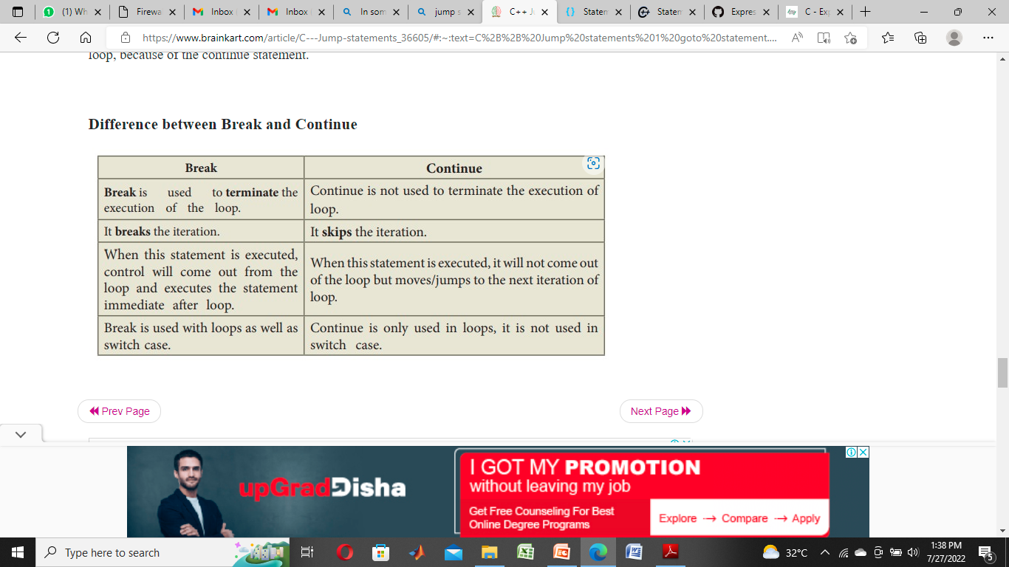

Slide 37
Array
C++ provides a data structure, the array, which stores a fixed-size sequential collection of elements of the same type.
An array is used to store a collection of data, but it is often more useful to think of an array as a collection of variables of the same type.
All arrays consist of contiguous memory locations. The lowest address corresponds to the first element and the highest address to the last element.

Slide 38
Declaring Arrays
To declare an array in C++, the programmer specifies the type of the elements and the number of elements required by an array as follows −
arrayName [ arraySize ];
This is called a single-dimension array. The arraySize must be an integer constant greater than zero and type can be any valid C++ data type.
For example, to declare a 10-element array called balance of type double, use this statement −
double balance[10];

Slide 39
Initializing Arrays
You can initialize C++ array elements either one by one or using a single statement as follows −
double balance[5] = {1000.0, 2.0, 3.4, 17.0, 50.0}; The number of values between braces { } can not be larger than the number of elements that we declare for the array between square brackets [ ].
Following is an example to assign a single element of the array −
If you omit the size of the array, an array just big enough to hold the initialization is created. Therefore, if you write −
double balance[] = {1000.0, 2.0, 3.4, 17.0, 50.0};

Slide 40
Accessing Array Elements
An element is accessed by indexing the array name.
This is done by placing the index of the element within square brackets after the name of the array.
For example −
double salary = balance[9];

Slide 41
Multidimensional arrays
C++ allows multidimensional arrays. Here is the general form of a multidimensional array declaration −
type na
me[size1][size2]...[sizeN];
Two-Dimensional Arrays
The simplest form of the multidimensional array is the two-dimensional array.
A two-dimensional array is, in essence, a list of one-dimensional arrays.
To declare a two-dimensional integer array of size x,y, you would write something as follows −
type arrayName [ x ][ y ];

Slide 42
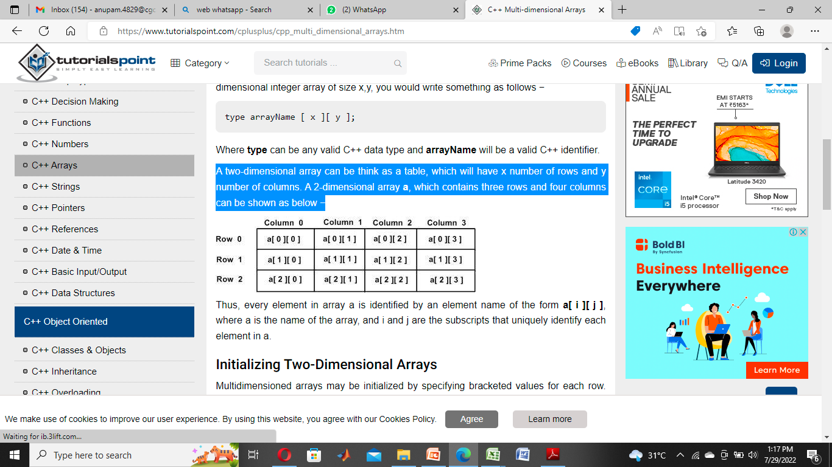
A two-dimensional array can be think as a table, which will have x number of rows and y number of columns.
A 2-dimensional array a, which contains three rows and four columns can be shown as below

Slide 43
Initializing Two-Dimensional Arrays
Multi dimensioned arrays may be initialized by specifying bracketed values for each row. Following is an array with 3 rows and each row have 4 columns.
int a[3][4] = { {0, 1, 2, 3} , /* initializers for row indexed by 0 */ {4, 5, 6, 7} , /* initializers for row indexed by 1 */ {8, 9, 10, 11} /* initializers for row indexed by 2 */ };

Slide 44
Example
#include <iostream>
using namespace std;
int main ()
{ // an array with 5 rows and 2 columns.
int a[5][2] = { {0,0}, {1,2}, {2,4}, {3,6},{4,8}};
// output each array element's value
for ( int i = 0; i < 5; i++ )
for ( int j = 0; j < 2; j++ )
{ cout << "a[" << i << "][" << j << "]: ";
cout << a[i][j]<< endl; }
return 0; }

Slide 45
String
C++ provides following two types of string representations −
The C-style character string.
The string class type introduced with Standard C++.
The C-Style Character String
The C-style character string originated within the C language and continues to be supported within C++.
This string is actually a one-dimensional array of characters which is terminated by a null character '\0'.
Thus a null-terminated string contains the characters that comprise the string followed by a null.
The following declaration and initialization create a string consisting of the word "Hello".
To hold the null character at the end of the array, the size of the character array containing the string is one more than the number of characters in the word "Hello."
char greeting[6] = {'H', 'e', 'l', 'l', 'o', '\0'};

Slide 46
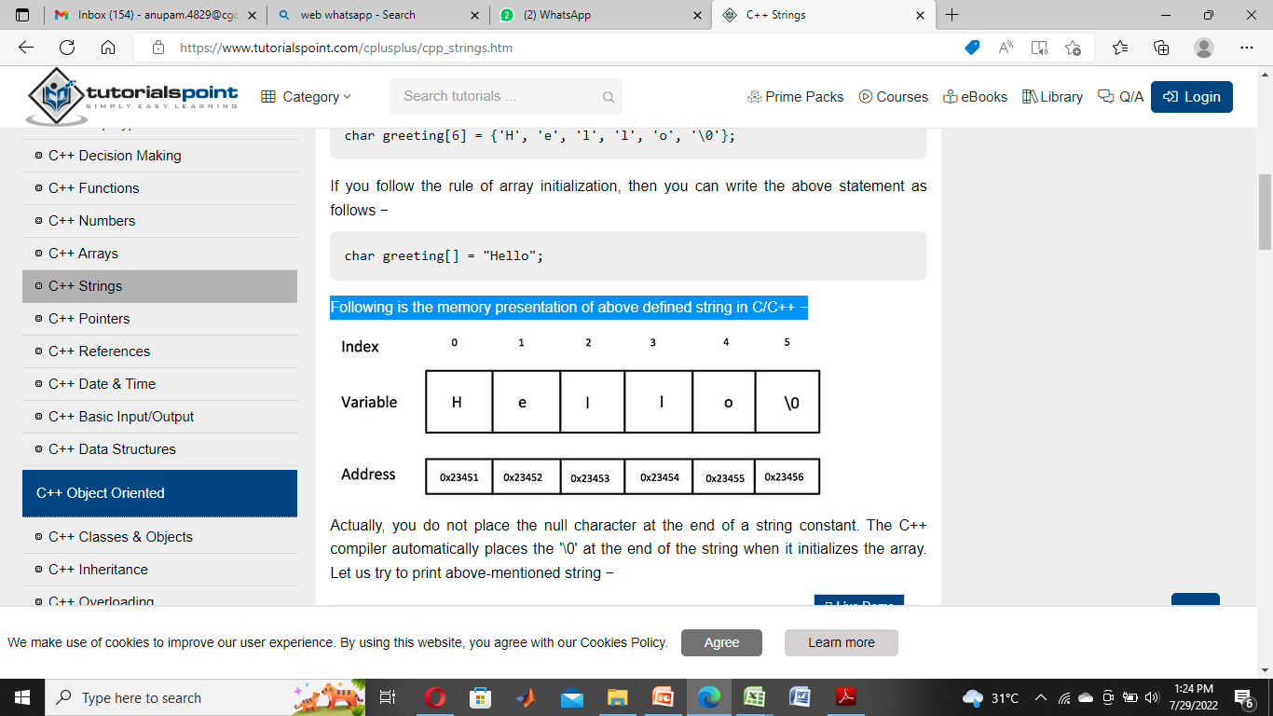
Following is the memory presentation of above defined string in C/C++ −

Slide 47
you do not place the null character at the end of a string constant.
The C++ compiler automatically places the '\0' at the end of the string when it initializes the array.
#include <iostream>
using namespace std;
int main ()
{ char greeting[6] = {'H', 'e', 'l', 'l', 'o', '\0'}; cout << "Greeting message: ";
cout << greeting << endl;
return 0; }

Slide 48
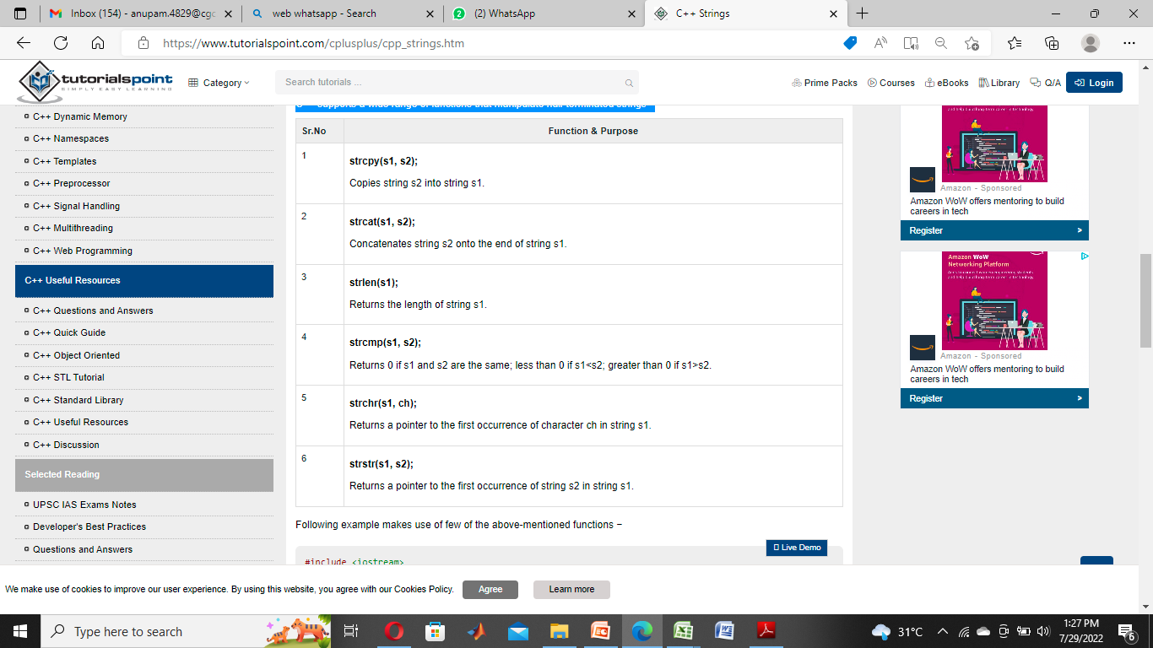
C++ supports a wide range of functions that manipulate null-terminated strings −

Slide 49
C++ Pointers
C++ pointers are easy and fun to learn. Some C++ tasks are performed more easily with pointers, and other C++ tasks, such as dynamic memory allocation, cannot be performed without them.
Every variable is a memory location and every memory location has its address defined which can be accessed using ampersand (&) operator which denotes an address in memory.
Consider the following which will print the address of the variables defined −
#include <iostream>
using namespace std;
int main ()
{ int var1; char var2[10];
cout << "Address of var1 variable: ";
cout << &var1 << endl;
cout << "Address of var2 variable: ";
cout << &var2 << endl; return 0; }

Slide 50
A pointer is a variable whose value is the address of another variable.
Like any variable or constant, you must declare a pointer before you can work with it.
The general form of a pointer variable declaration is −
type *var-nam
type is the pointer's base type; it must be a valid C++ type and var-name is the name of the pointer variable.
The asterisk you used to declare a pointer is the same asterisk that you use for multiplication.
However, in this statement the asterisk is being used to designate a variable as a pointer.
Following are the valid pointer declaration −
int *ip; // pointer to an integer
double *dp; // pointer to a double
float *fp; // pointer to a float
char *ch // pointer to character e;

Slide 51
Using Pointers in C++
There are few important operations, which we will do with the pointers very frequently.
(a) We define a pointer variable.
(b) Assign the address of a variable to a pointer.
(c) Finally access the value at the address available in the pointer variable.
This is done by using unary operator * that returns the value of the variable located at the address specified by its operand.

Slide 52
#include <iostream>
using namespace std;
int main ()
{ int var = 20; // actual variable declaration.
int *ip; // pointer variable
ip = &var; // store address of var in pointer variable
cout << "Value of var variable: ";
cout << var << endl;
// print the address stored in ip pointer variable
cout << "Address stored in ip variable: ";
cout << ip << endl;
// access the value at the address available in pointer
cout << "Value of *ip variable: ";
cout << *ip << endl; return 0; }

Slide 53
C++ Functions
A function is a block of code which only runs when it is called.
You can pass data, known as parameters, into a function.
Functions are used to perform certain actions, and they are important for reusing code: Define the code once, and use it many times.

Slide 54
Create a Function
C++ provides some pre-defined functions, such as main(), which is used to execute code. But you can also create your own functions to perform certain actions.
To create (often referred to as declare) a function, specify the name of the function, followed by parentheses ():
Syntax
Void Function()
{
// code to be executed
}

Slide 55
Example
myFunction() is the name of the function
void means that the function does not have a return value. You will learn more about return values later in the next chapter
inside the function (the body), add code that defines what the function should do

Slide 56
Declared functions are not executed immediately. They are "saved for later use", and will be executed later, when they are called.
To call a function, write the function's name followed by two parentheses () and a semicolon ;
In the following example, myFunction() is used to print a text (the action), when it is called:

Slide 57
Inside main, call myFunction():
// Create a function
void myFunction() {
cout << "I just got executed!";
}
int main() {
myFunction(); // call the function
return 0;
}
// Outputs "I just got executed!"

Slide 58
C++ Recursion
Recursion is the technique of making a function call itself.
This technique provides a way to break complicated problems down into simple problems which are easier to solve.
Recursion may be a bit difficult to understand. The best way to figure out how it works is to experiment with it.

Slide 59
Recursion Example
Maze Solving: In maze-solving algorithms, recursion can be used to explore different paths until a solution is found. The algorithm explores a path, and if it reaches a dead-end, it backtracks and explores other paths until it finds the exit.
Maze Solving: In maze-solving algorithms, recursion can be used to explore different paths until a solution is found. The algorithm explores a path, and if it reaches a dead-end, it backtracks and explores other paths until it finds the exit.

Slide 60
Adding two numbers together is easy to do, but adding a range of numbers is more complicated.
In the following example, recursion is used to add a range of numbers together by breaking it down into the simple task of adding two numbers:

Slide 61
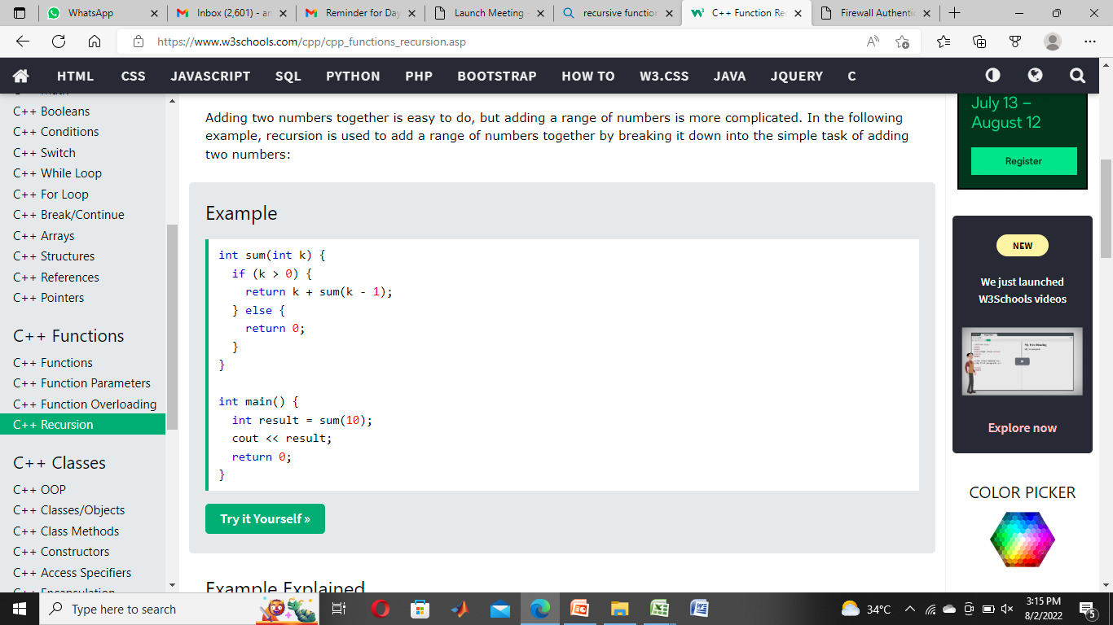

Slide 62
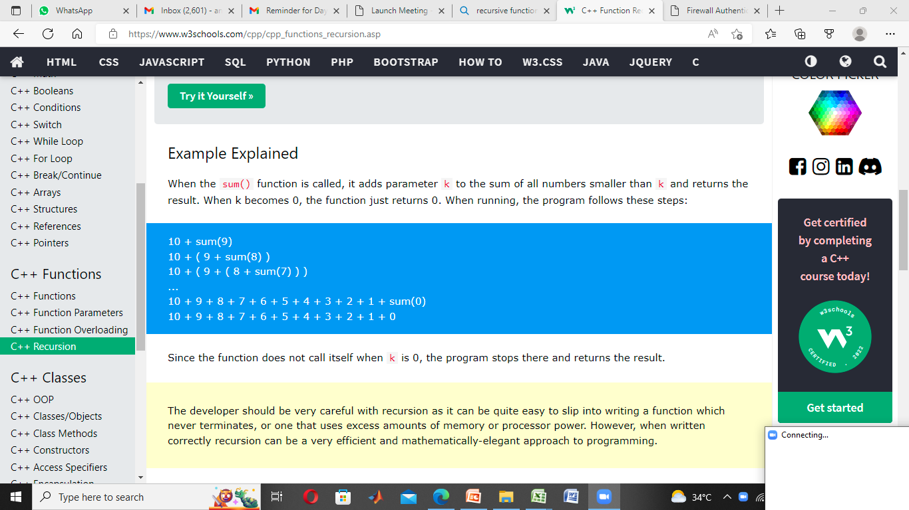
When the sum() function is called, it adds parameter k to the sum of all numbers smaller than k and returns the result.
When k becomes 0, the function just returns 0. When running, the program follows these steps:

Slide 63
The developer should be very careful with recursion as it can be quite easy to slip into writing a function which never terminates, or one that uses excess amounts of memory or processor power.
However, when written correctly recursion can be a very efficient and mathematically-elegant approach to programming.

Slide 64
User Defined Data Types in C++
User Defined Data type in c++ is a type by which the data can be represented.
The type of data will inform the interpreter how the programmer will use the data.
A data type can be pre-defined or user-defined.
Examples of pre-defined data types are char, int, float, etc. We will discuss user-defined data types in detail.

Slide 65
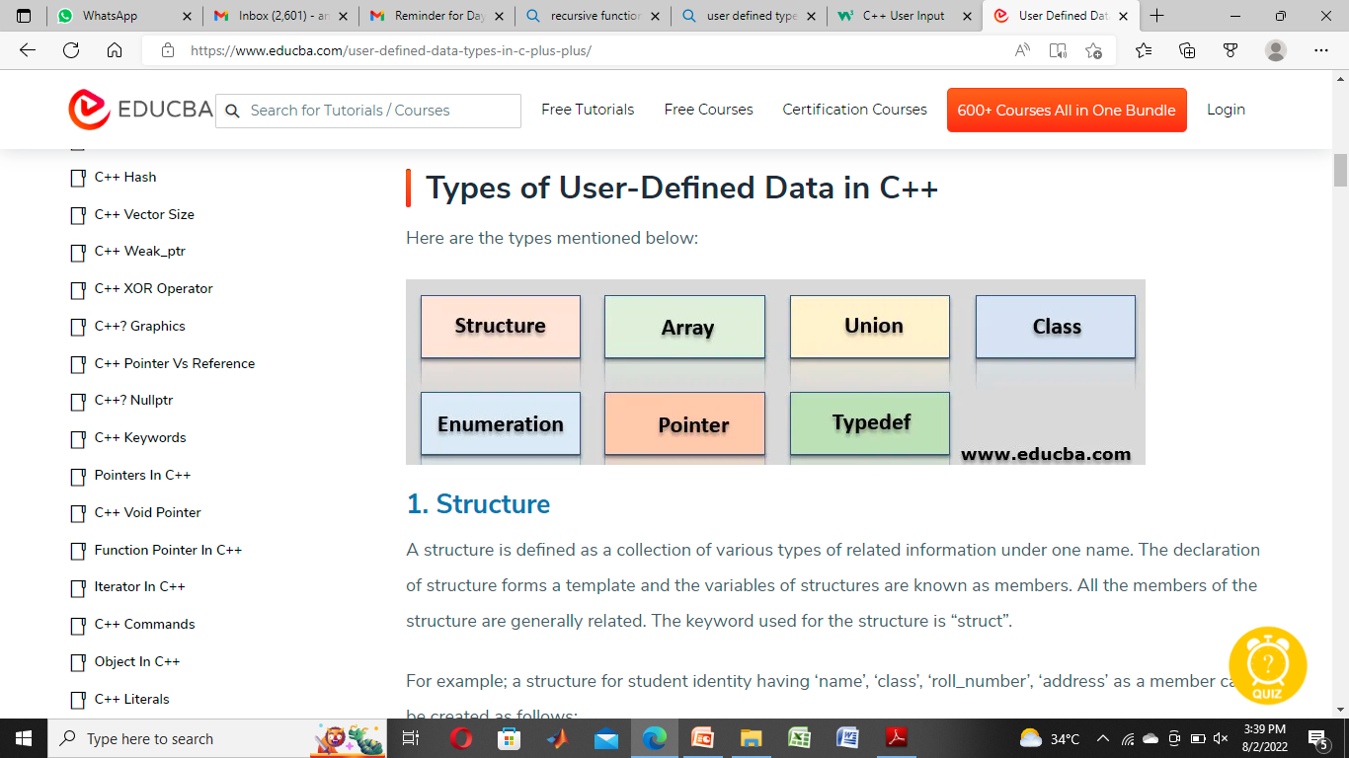

Slide 66
Structure
A structure is defined as a collection of various types of related information under one name.
The declaration of structure forms a template and the variables of structures are known as members.
All the members of the structure are generally related. The keyword used for the structure is “struct”.
For example; a structure for student identity having ‘name’, ‘class’, ‘roll_number’, ‘address’ as a member can be created as follows:

Slide 67
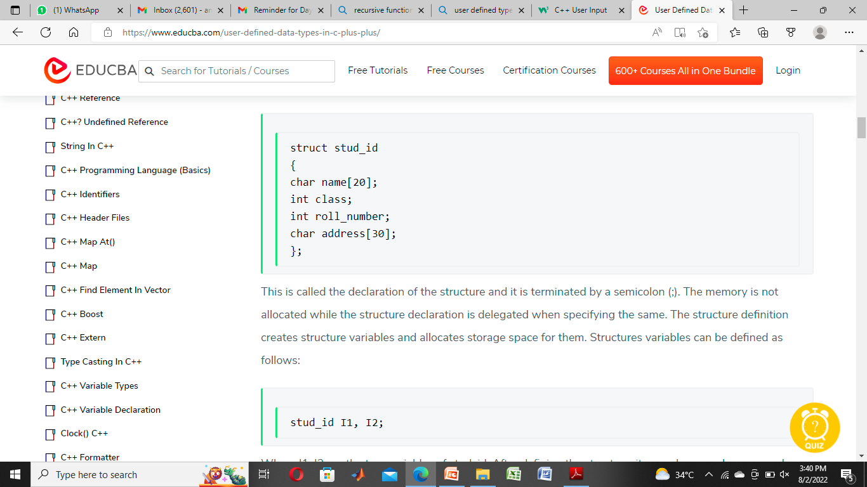

Slide 68
Unions
A union is a special data type available in C that allows to store different data types in the same memory location.
You can define a union with many members, but only one member can contain a value at any given time.
Unions provide an efficient way of using the same memory location for multiple-purpose.

Slide 69
Defining a Union
To define a union, you must use the union statement in the same way as you did while defining a structure.
The union statement defines a new data type with more than one member for your program.
The format of the union statement is as follows −
union [union tag] { member definition; member definition; ... member definition; } [one or more union variables];

Slide 70
union Data
{ int i;
float f;
char str[20]; }
data;
a variable of Data type can store an integer, a floating-point number, or a string of characters.
It means a single variable, i.e., same memory location, can be used to store multiple types of data.
You can use any built-in or user defined data types inside a union based on your requirement.
The memory occupied by a union will be large enough to hold the largest member of the union.
For example, in the above example, Data type will occupy 20 bytes of memory space because this is the maximum space which can be occupied by a character string.

Slide 71
#include <stdio.h>
#include <string.h>
union Data
{ int i;
float f;
char str[20]; };
int main( )
{ union Data data;
printf( "Memory size occupied by data : %d\n", sizeof(data));
return 0; }

Slide 72
Function Overloading
Two or more functions may share the same name but not the same list of arguments when functional overloading occurs.
It is a key characteristic of C++. Compile-time polymorphism and function overloading are similar concepts.
A close examination reveals that the name stays the same, although the list of arguments, data type, and order all change.

Slide 73
Real Life Example
HTTP Request Handling:
In web development, function overloading can be employed to handle different types of HTTP requests such as GET, POST, PUT, DELETE, etc. Each type of request performs a different operation on the server-side, and using function overloading can help manage the server's request handling more efficiently.

Slide 74
Drawing Shapes:
function overloading can be used is in a graphics library that deals with drawing different shapes like circles, rectangles, and triangles.
Currency Converter:
Consider a currency converter application that needs to handle different types of currency conversions, such as USD to EUR, EUR to JPY, etc. We can use function overloading to create multiple conversion functions for each currency pair.

Slide 75
Sorting Algorithms:
In a sorting algorithm library, we can use function overloading to handle different data types or customize the sorting order.
File Handling:
In a file handling module, function overloading can be used to read files of different formats (e.g., CSV, JSON, XML) or write data to files in different ways (e.g., overwrite, append).

Slide 76
Code Example
#include <iostream>
using namespace std;
class Cal {
public:
static int add(int a,int b){
return a + b;
}
static int add(int a, int b, int c)
{
return a + b + c;
}
};
int main(void) {
Cal C; // class object declaration.
cout<<C.add(10, 20)<<endl;
cout<<C.add(12, 20, 23);
return 0;
}

Slide 77
Inline Function
The inline keyword tells the compiler to substitute the code within the function definition for every instance of a function call.
Using inline functions can make your program faster because they eliminate the overhead associated with function calls. The compiler can optimize functions expanded inline in ways that aren't available to normal functions.
Inline code substitution occurs at the compiler's discretion. For example, the compiler won't inline a function if its address is taken or if it's too large to inline.
A function defined in the body of a class declaration is implicitly an inline function.

Slide 78
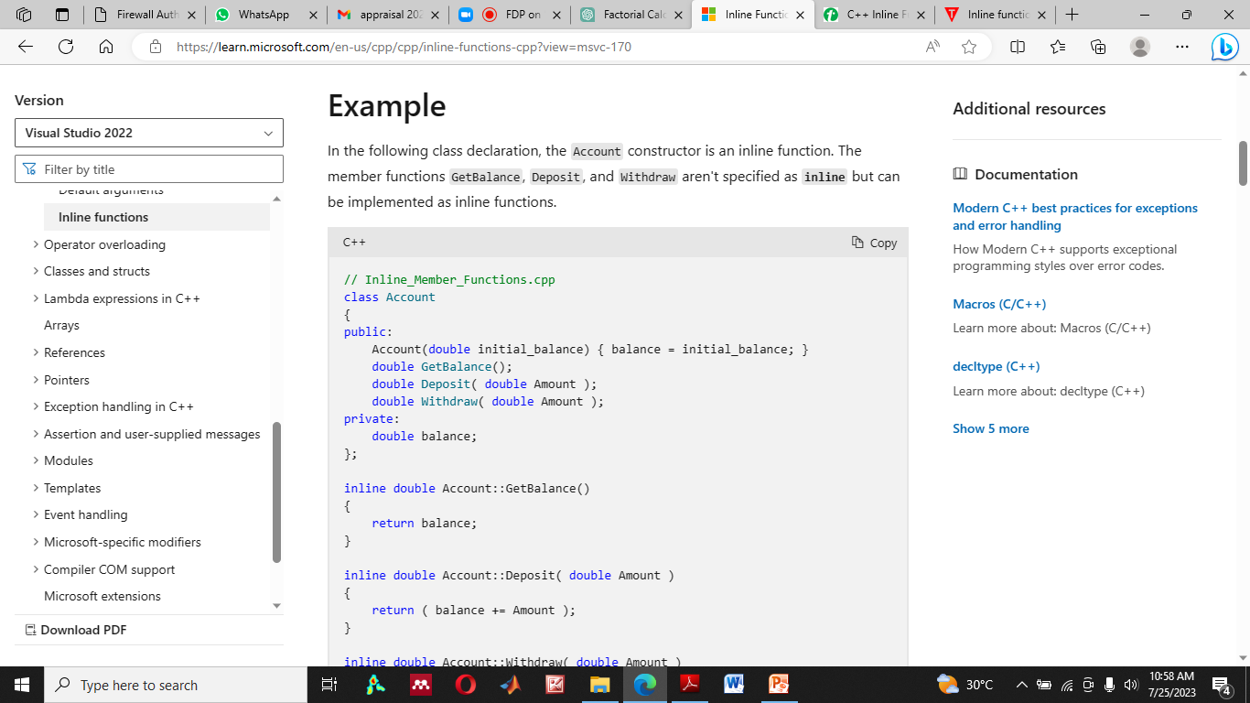

Slide 79
Logging Utility
a logging utility in a programming language that contains a small set of inline functions for logging messages at different log levels (e.g., debug, info, warning, error).
Since logging functions are commonly called throughout the codebase, using inline functions can potentially improve performance by reducing function call overhead.

Slide 80
Scope Resolution Operator in C++
The Scope Resolution Operator in C++ is used to reference the global variable or member function that is out of scope.
So, we use the scope resolution operator to access the hidden variable or function of a program.
The operator is represented as the double colon (::) symbol.

Slide 81
Uses of Scope Resolution Operator in C++
It is used to access the global variables or member functions of a program when there is a local variable or member function with the same name
It is used to define the member function outside of a class.
It is also used to access the static variable and static function of a class.
In the case of multiple Inheritance, it is used to override the function.
For namespace: If a class having the same name exists inside two namespaces, we can use the namespace name with the scope resolution operator to refer to that class without any conflicts
Refer to a class inside another class: If a class exists inside another class, we can use the nesting class to refer to the nested class using the scope resolution operator

Slide 82
class Rectangle
{
private:
int length;
int breadth;
public:
Rectangle (int l, int b){
length = l;
breadth = b;
}
int area ()
{
return length * breadth;
}
int perimeter ();
};

Slide 83
Passing object as an argument
you can pass objects as arguments to functions in several ways.
Objects can be passed by value, by reference, or by pointer.
Each method has its implications, and the choice depends on the specific requirements of your program.

Slide 84
Passing by Value: When you pass an object by value, a copy of the object is made, and the function works with this copy. This means that any changes made to the object inside the function do not affect the original object outside the function.
Passing by Reference: When you pass an object by reference, the function receives a reference to the original object. Any changes made to the object inside the function directly affect the original object outside the function.

Slide 85
Passing by Reference: When you pass an object by reference, the function receives a reference to the original object. Any changes made to the object inside the function directly affect the original object outside the function.

Slide 86
Returning object
Returning objects from functions in C++ is a powerful feature that allows you to create and return instances of classes.
When you return an object from a function, you are essentially returning a copy of that object, which means you can use the returned object just like any other object of that class.

Slide 87
int main() {
MyClass obj1(10);
MyClass obj2(20);
obj2 = obj1; // Assign obj1's value to obj2
std::cout << "obj1.value: " << obj1.value << std::endl; // Output: 10
std::cout << "obj2.value: " << obj2.value << std::endl; // Output: 10 (obj2 now has the same value as obj1)

Slide 88
Object Assignment
Object assignment in C++ allows you to copy the values of one object into another object of the same class.
This is achieved using the assignment operator =. The default assignment operator provided by C++ performs a shallow copy, which means member-wise copy of the values.
However, for classes that involve dynamic memory allocation or other resources, a custom assignment operator is often necessary to ensure deep copying and proper resource management.

